Slide 1
Croatian economy –
Lessons learned from Estonia
Kristjan Lepik

Slide 2
1. Lessons learned from Estonia’s reforms
2. Ideas for Croatia

Slide 3
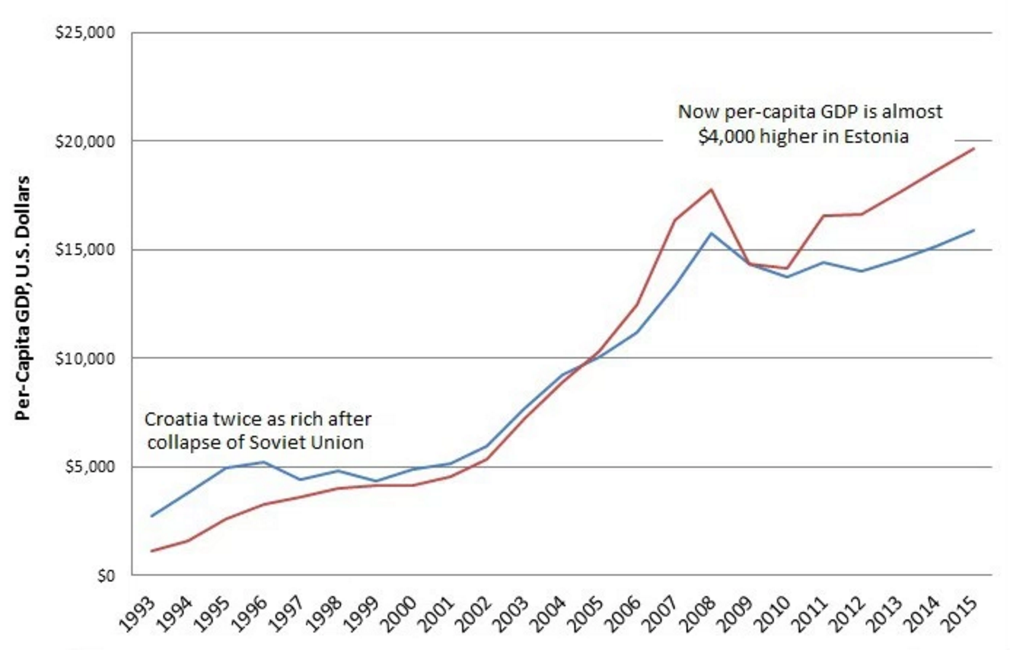
ESTONIA vs CROATIA, GDP GROWTH (1993-2015)

Slide 4
Keys to growth in Estonia
1. E-government (incl. e-residency)
2. Focus on technology
3. Open Estonia – how to be attractive to capital and talent

Slide 5
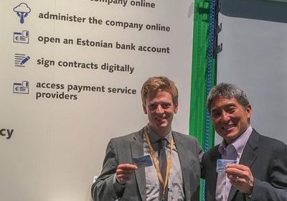
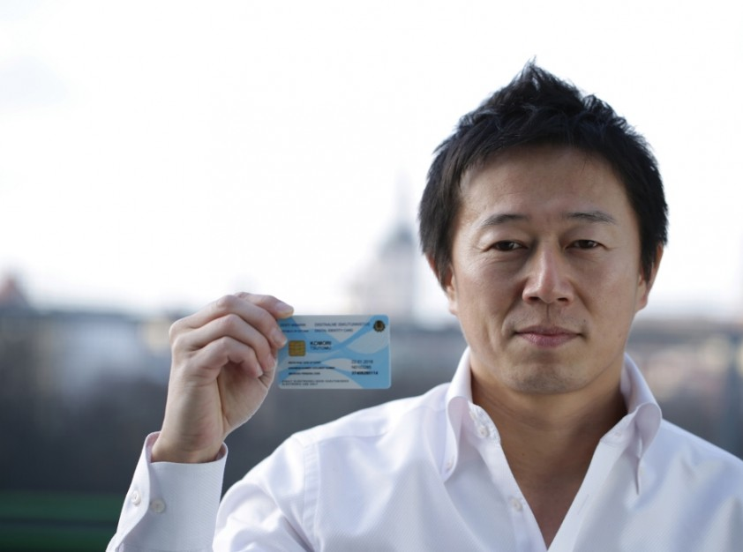
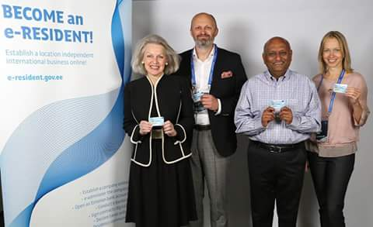
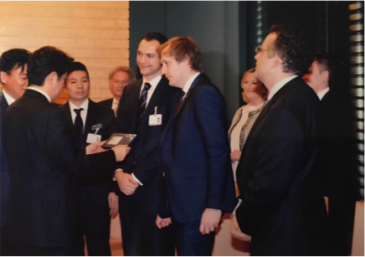
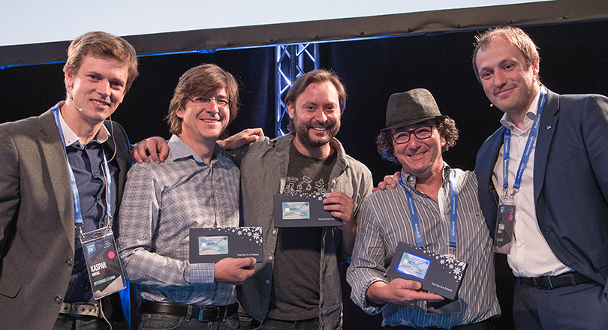
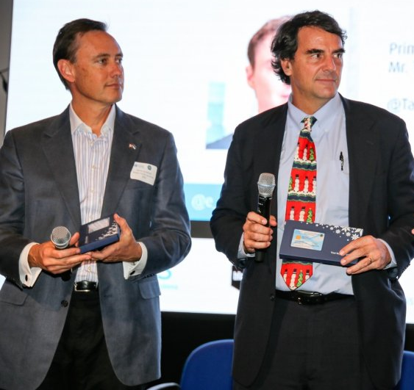
Parim infra

Slide 6
FOCUS ON TECHNOLOGY

Slide 7
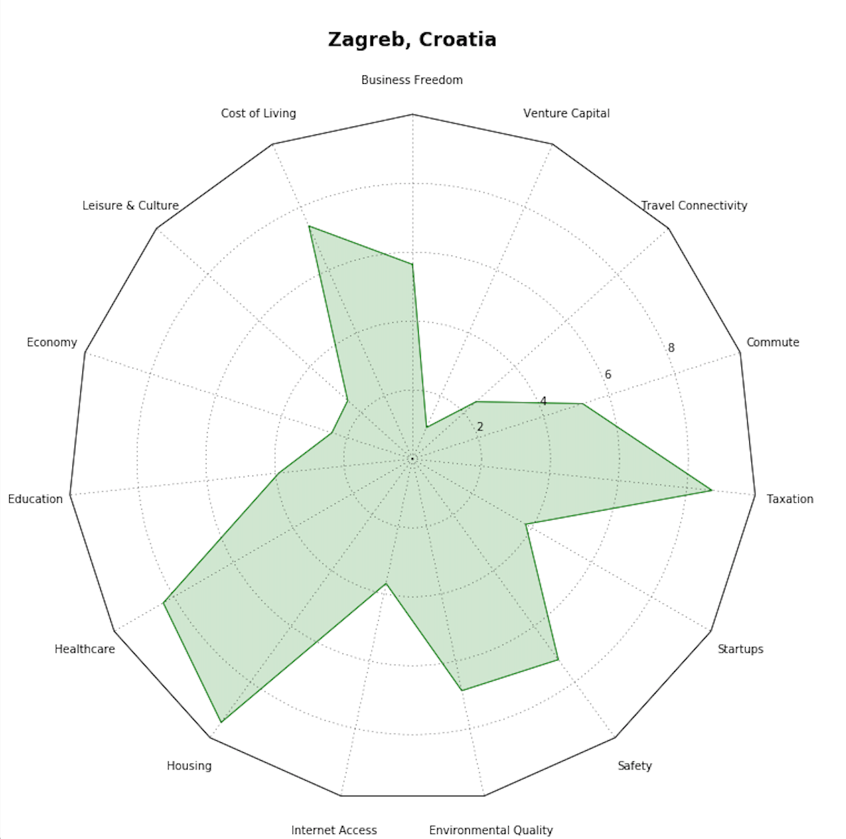
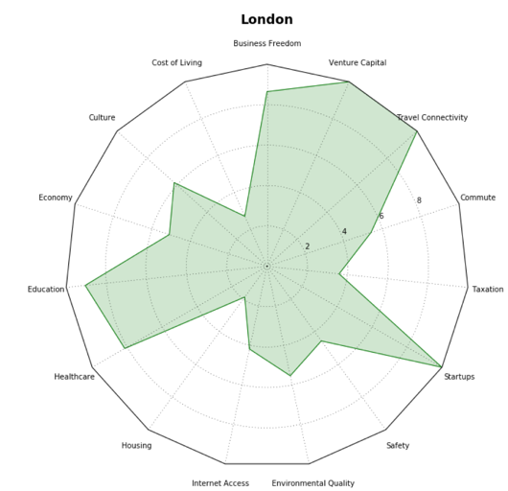
ZAGREB vs LONDON

Slide 8
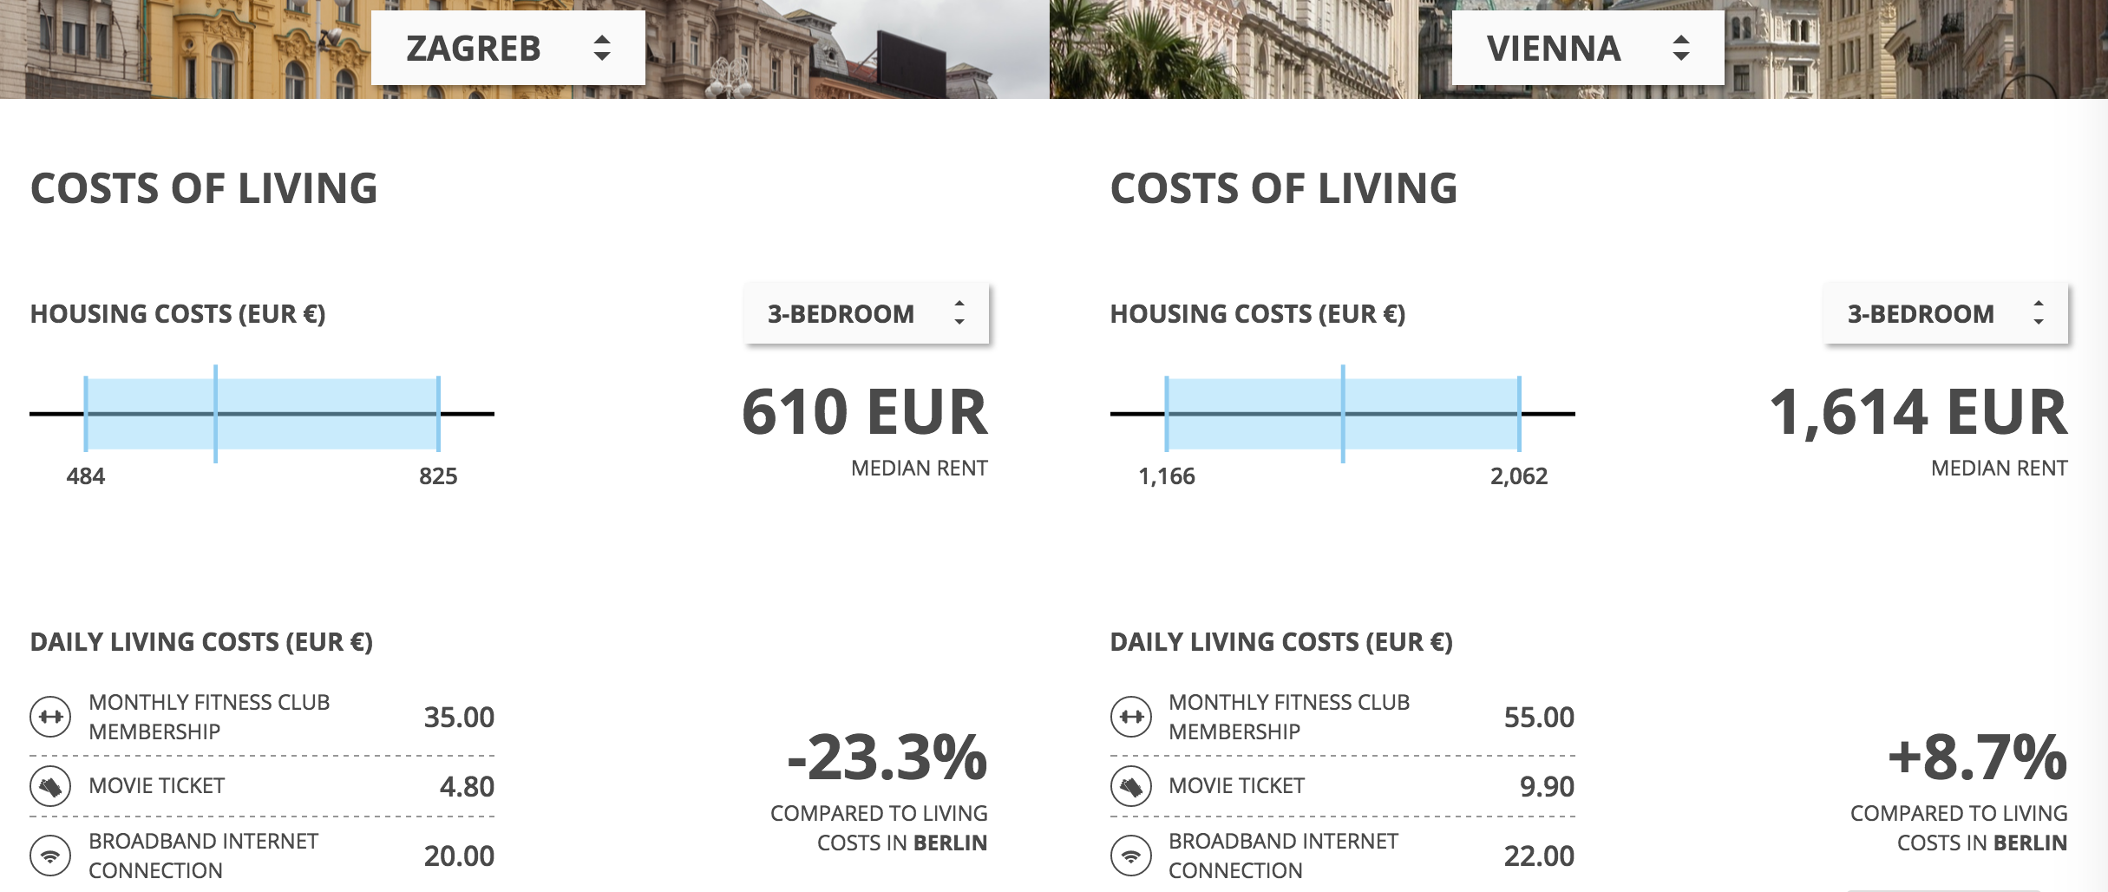
FREE PEOPLE MOVE | teleport.org

Slide 9
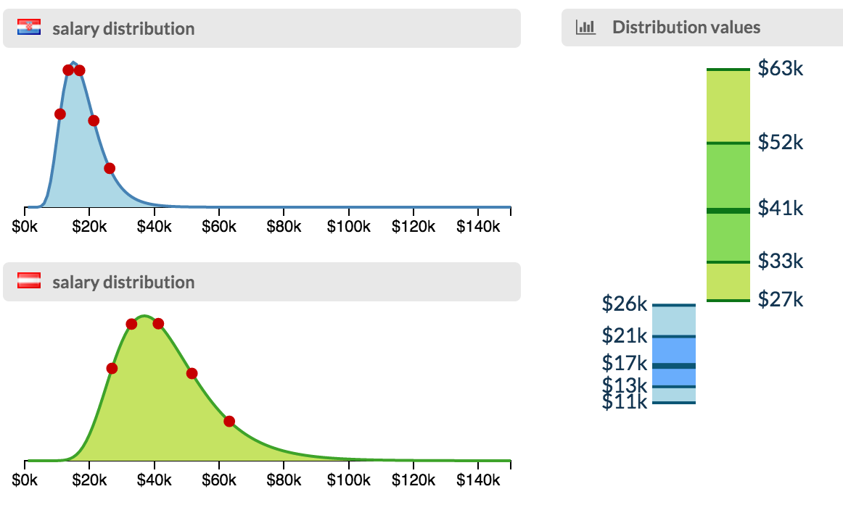
SALARY DISTRIBUTION – ZAGREB VS VIENNA, SOFTWARE ENGINEERS
FREE PEOPLE MOVE | teleport.org

Slide 10
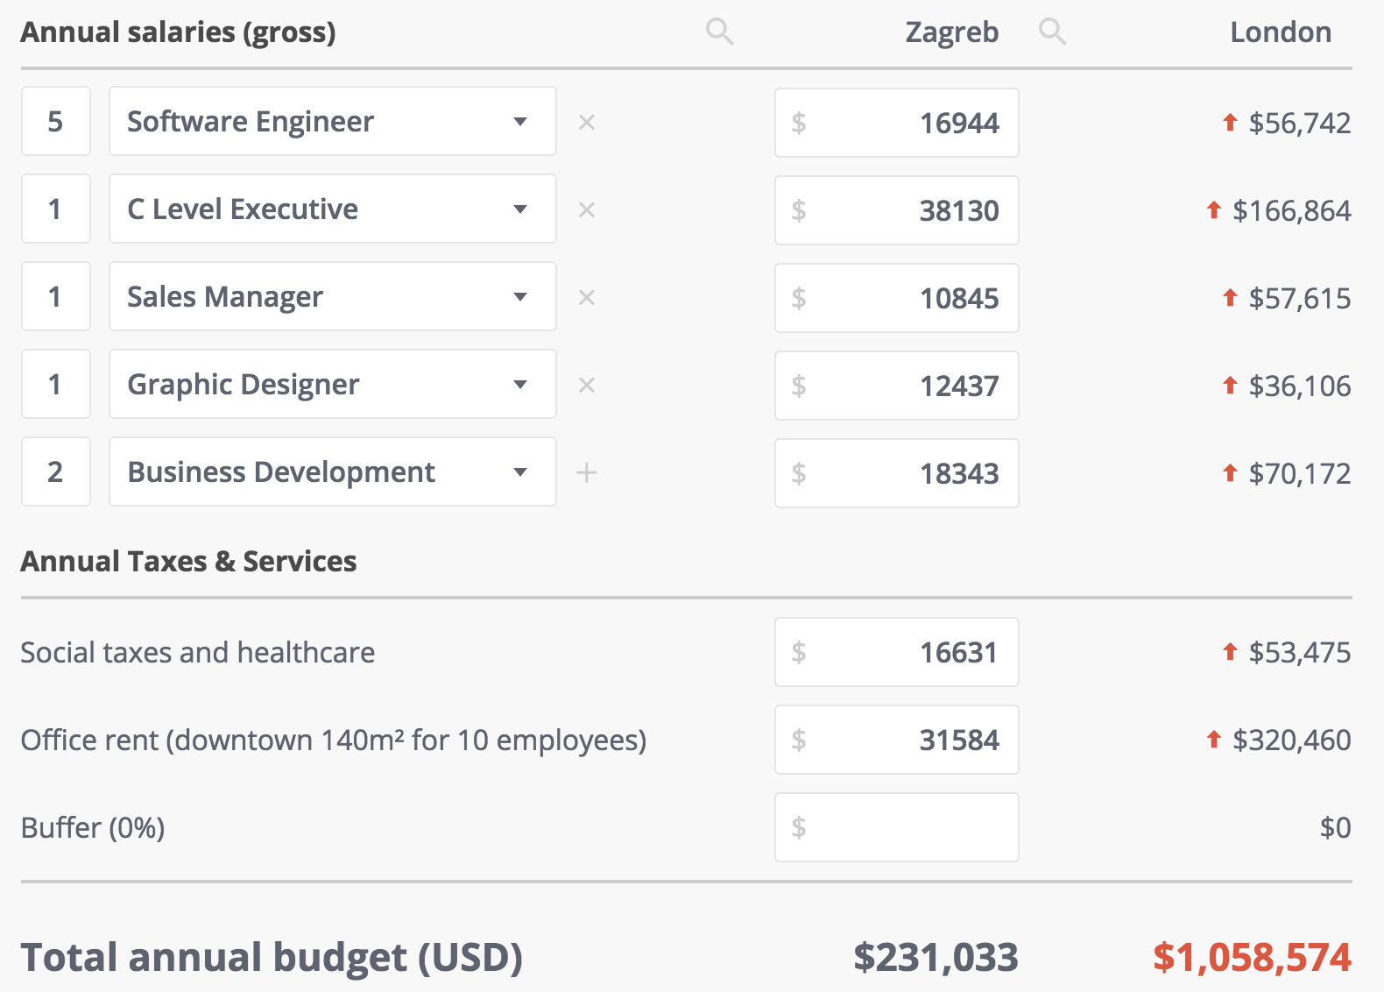
TALLINN vs HELSINKI
STARTUP WITH 10 PERSONS ZAGREB vs LONDON

Slide 11
There is no single best place for everything
Engineers
Users
Designers
Funding
Climate

Slide 12
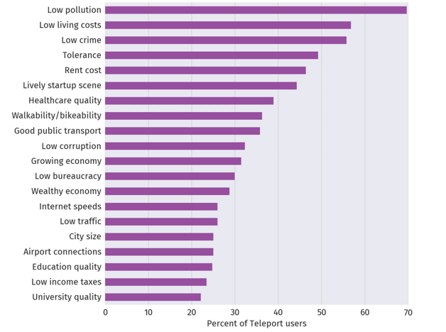
WHAT ARE THE MOST IMPORTANT ISSUES FOR TALENT?
Based on data provided by users of Teleport
FREE PEOPLE MOVE | teleport.org

Slide 13
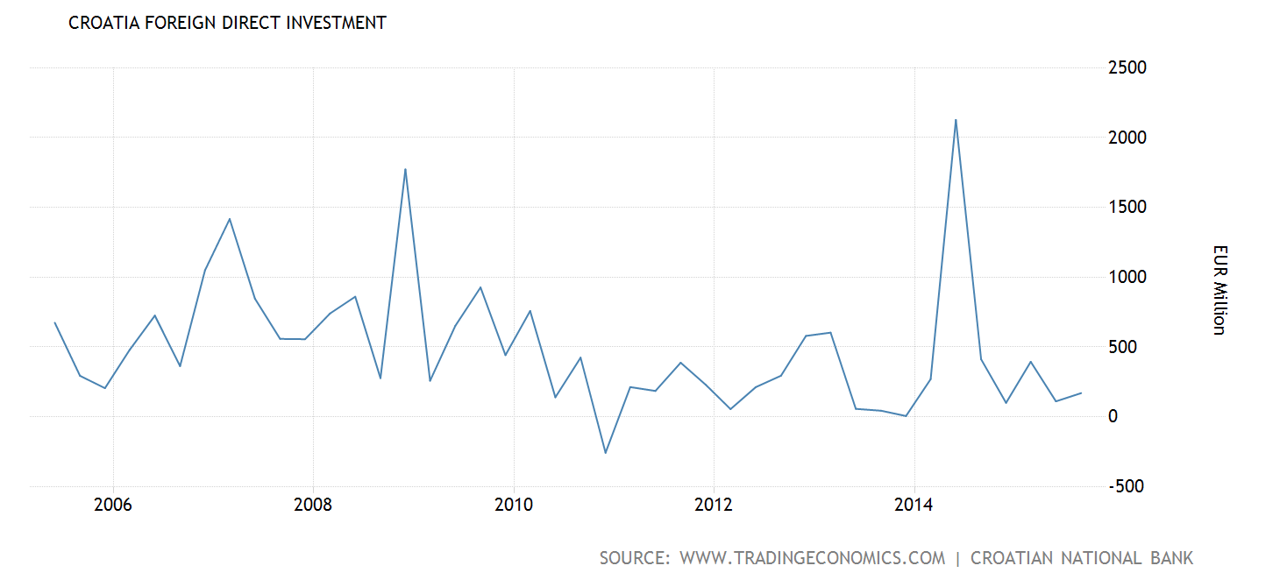
OPEN ECONOMY – HOW TO INCREASE FOREIGN INVESTMENTS?
FREE PEOPLE MOVE | teleport.org

Slide 14
Keys to growth in Croatia
Open Croatia 1. Be attractive to foreign investments
2. Be attractive to talent
3. Business reforms - Ease of Doing business today Croatia is 40th target – place nr 25!

Slide 15
Kristjan Lepik
kristjan@teleport.org
phn +372-5023981
MOVE TO: teleport.org
FOLLOW: @TeleportInc
PLACE SCOUT FOR STARTUP PEOPLE | teleport.org

